Slide 1
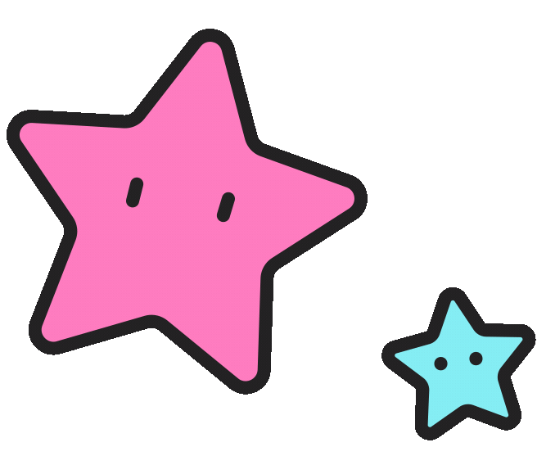
冒險故事
(Vtube studio)

Slide 2
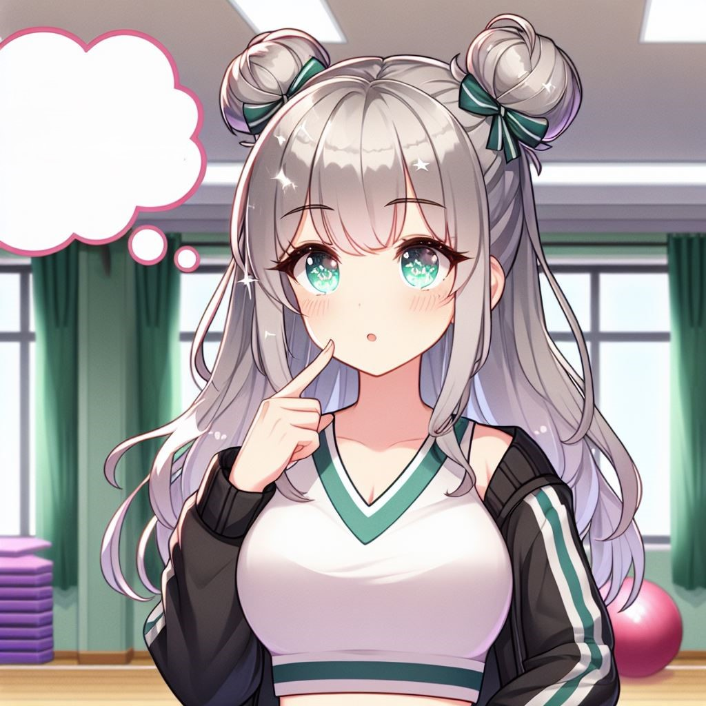
1. 目標
Notes:
日本動漫風格女生。She has silver-gray hair with a little tiffany green highlights, flat bangs, two buns, and tiffany green-pink eyes. With the gym in the background, she's thinking about new cheerleading choreography. I want adialog box above the head.

Slide 3
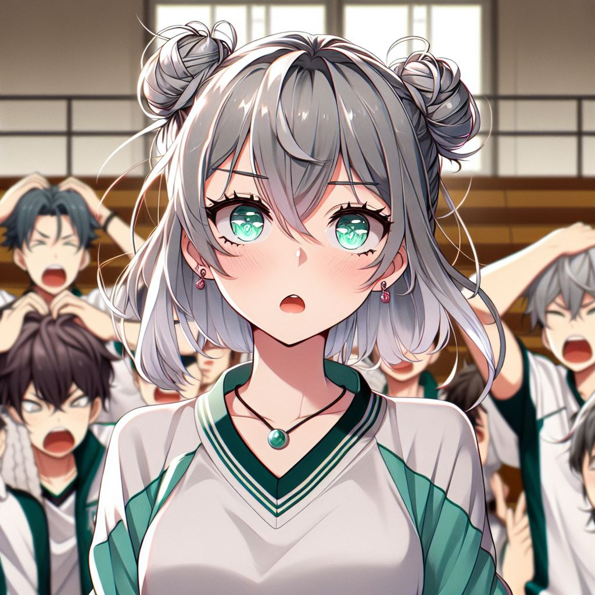
2. 阻礙
Notes:
日本動漫風格女生。She has silver-gray hair with a little tiffany green highlights, flat bangs, two buns, and tiffany green-pink eyes. With the gym in the background and the teammates and coaches around her shook their heads. Add some disappointed expressions on the teammates' faces.

Slide 4
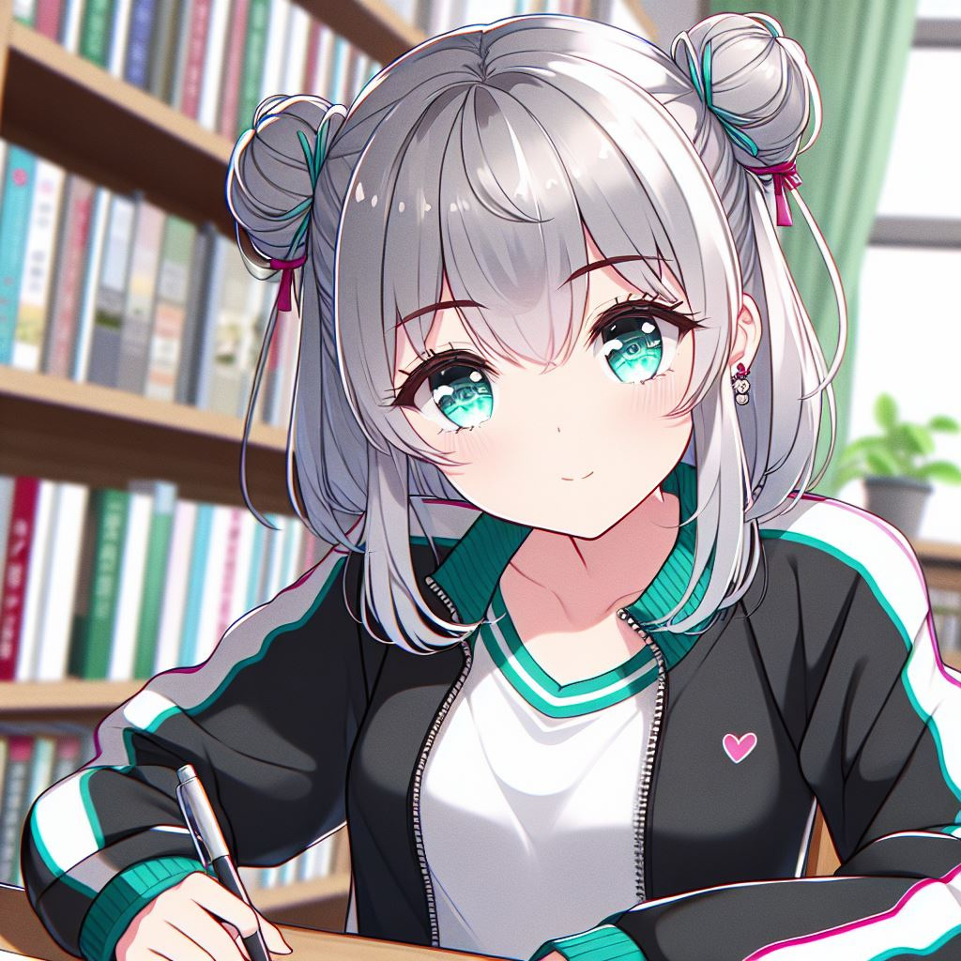

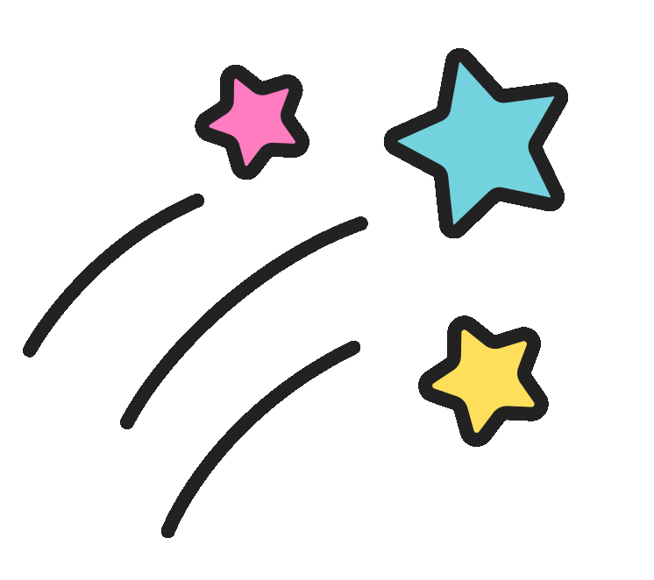

3. 努力
Notes:
日本動漫風格女生。She has silver-gray hair with a little tiffany green highlights, flat bangs, two buns, and tiffany green-pink eyes.Wear sportswear. 低著頭坐在書桌上拿著一支筆. Add a background with books.

Slide 5
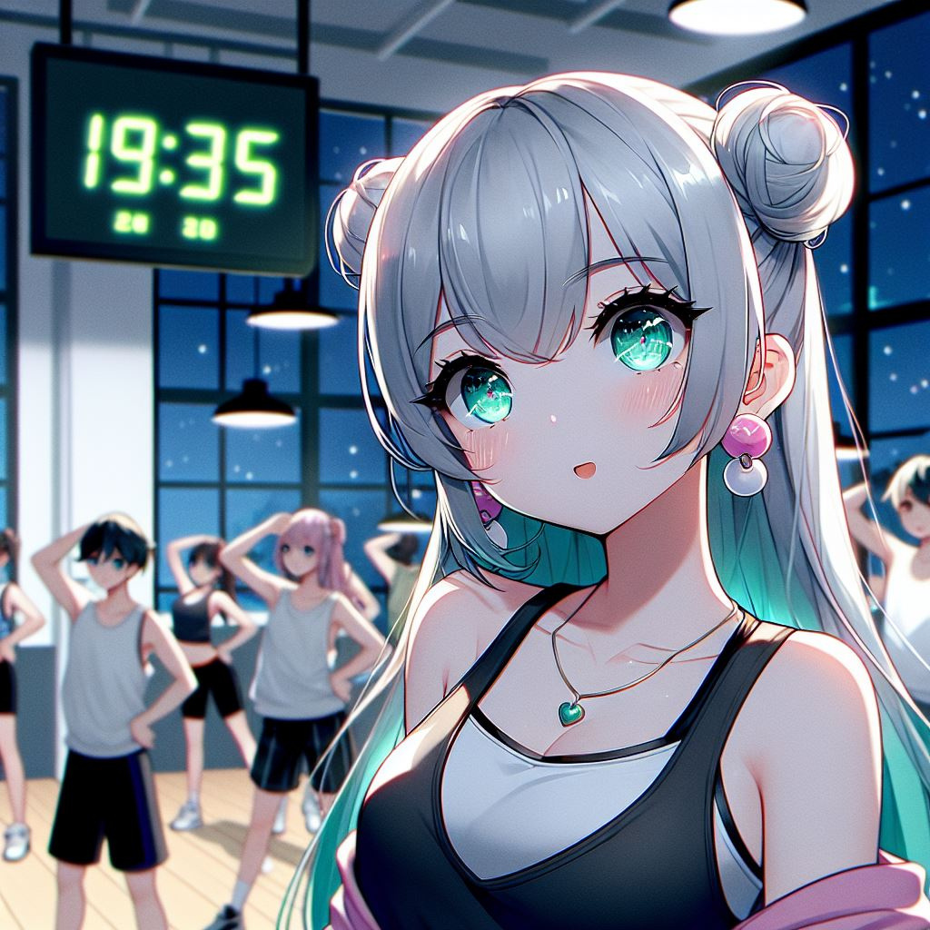
Notes:
日本動漫風格女生。She has silver-gray hair with a little tiffany green highlights, flat bangs, two buns, and tiffany green-pink eyes. With the gym in the background.add an electronic clock to the background to show 19:35.It's night outside the window. practice dance the with teammates

Slide 6
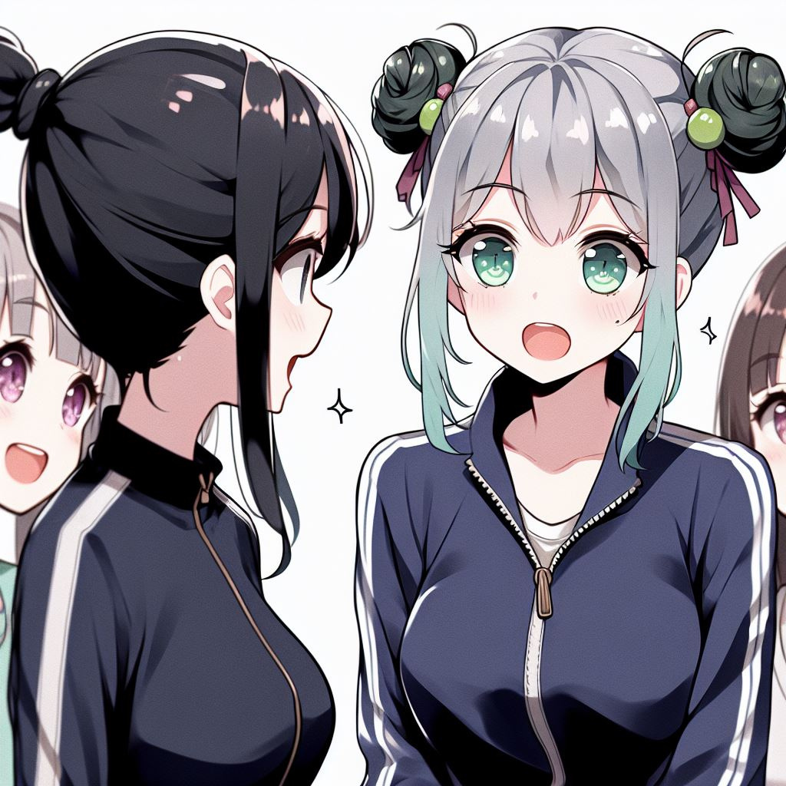

4. 結果
Notes:
日本動漫風格，一位穿著深藍色運動套裝且黑色頭髮綁馬尾的中年女生在跟有一頭銀灰色且帶有一點蒂芙尼綠亮點的頭髮，平劉海，兩個髮髻，蒂芙尼綠粉色的眼睛的女生說話。旁邊圍繞著隊友們。兩個人和周圍的人都在微笑

Slide 7
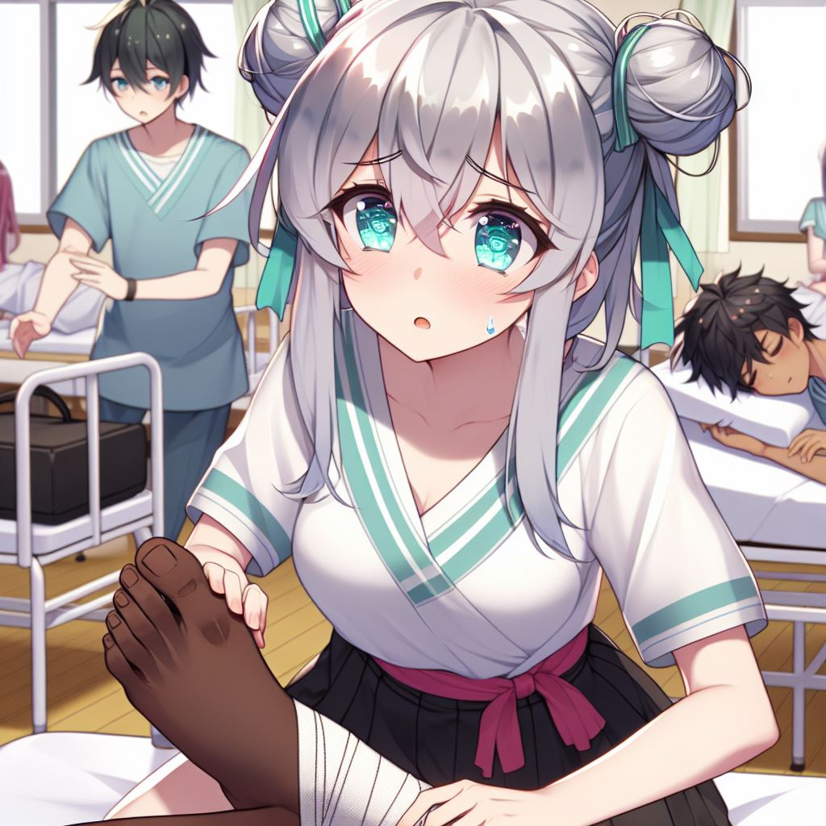
5. 意外
Notes:
Japanese style anime girls. Just wear normal clothes. In the background is the health room. She was bandaging her teammate's foot, a worried look on her face.

Slide 8
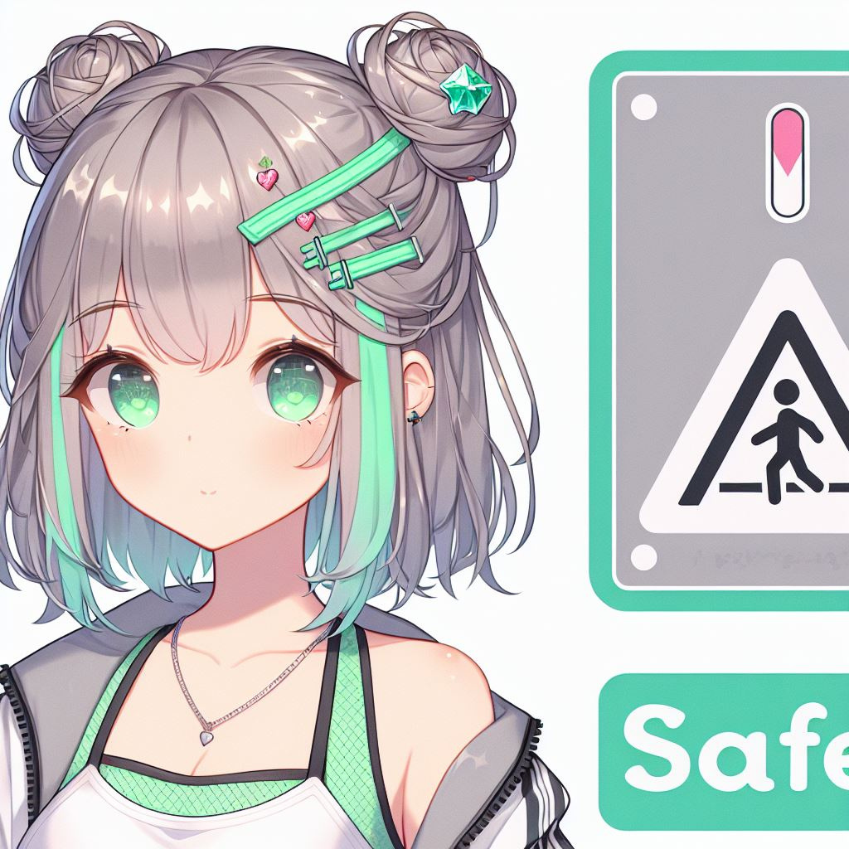
6. 轉彎
Notes:
日本動漫風格女生。She has silver-gray hair with a little tiffany green highlights, flat bangs, two buns, and tiffany green-pink eyes.Wear sportswear.旁邊寫著safety first的牌子

Slide 9
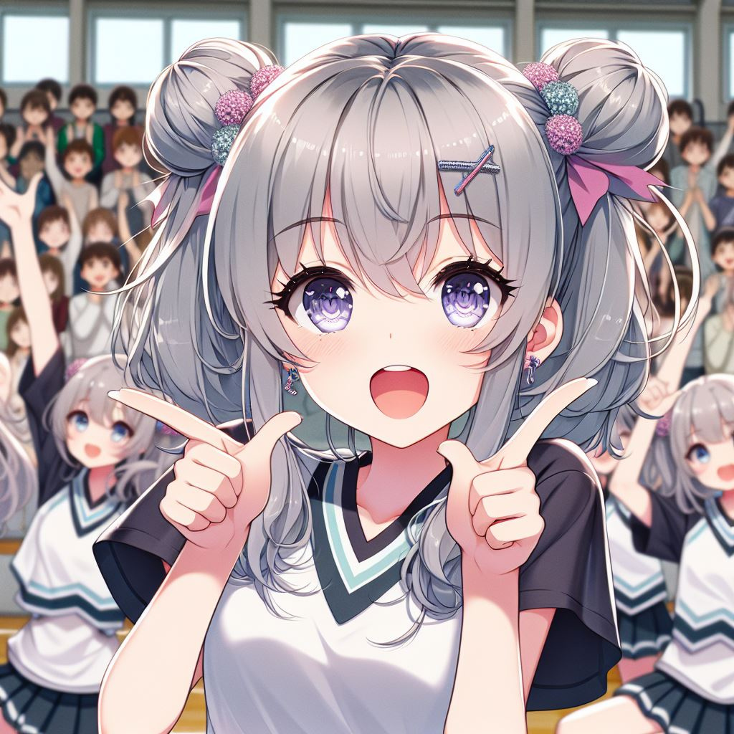
7. 結局
Notes:
日本動漫風格女生。She has silver-gray hair with a little tiffany green highlights, flat bangs, two buns, and tiffany green-pink eyes. In the background is the indoor gymnasium and the audience behind them are clapping their hands and applauding, doing cheerleading gestures with their teammates. Make sure to show synchronized movements among the teammates.

Slide 10
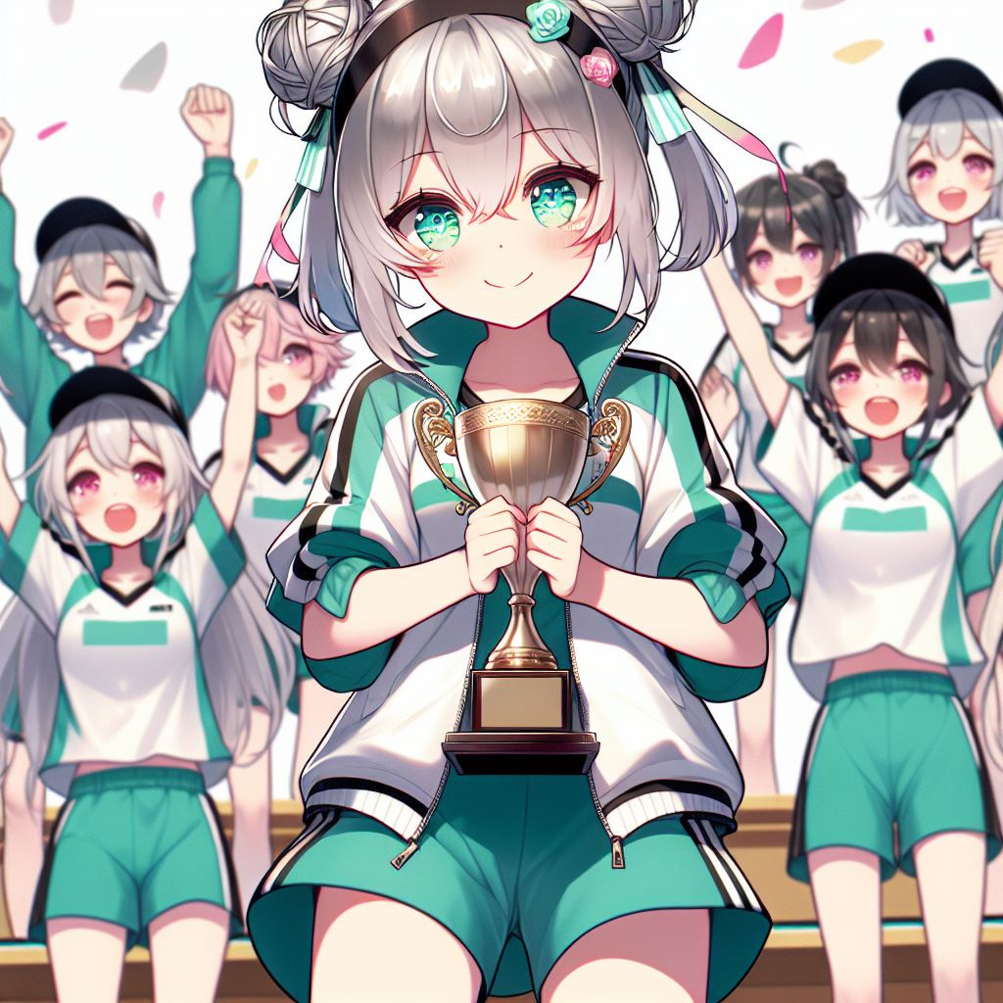
Notes:
日本動漫風格女生。She has silver-gray hair with a little tiffany green highlights, flat bangs, two buns, and tiffany green-pink eyes.Wear sportswear. 站在頒獎台上. Add a trophy in her hands. add some teammate around

